Slide 1
Together towards
a sustainable world

Slide 3
An academic and scientific body

Slide 4
Engineering and management institute
+9 000
students
including 900
phD students
1 250
graduates/year
40
laboratories
270
patent and software applications
8
graduate schools

Slide 5
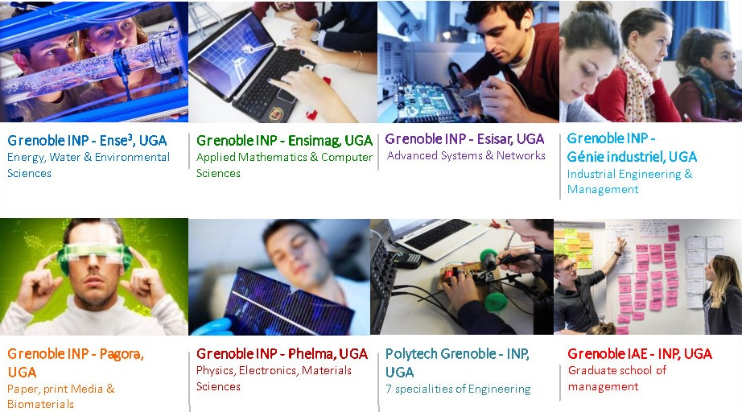
8 graduate schools of Engineering 1 graduate school of Management

Slide 6
Grenoble INP - Pagora
200
students
65
graduates
Per year
1
engineering degree (Masters)
1
school
1
Apprentice Training Center
1
masters
1
laboratoire (LGP2)
40%
female students

Slide 8
Reducing climate impact
More sustainable
More organic
More recyclable
More functions
Less energy
Less toxicity
Less waste
Less material
Green carbon and circular economy,
the keystones of sustainable development
Grenoble INP – Pagora
The path to a sustainable world

Slide 9
The path to a sustainable world
Engineers trained to fulfil society’s needs
Traditional sectors newly focused on green chemistry and innovation
Wood
Cellulose
Paper
Packaging
Processes
Printing
Biosourcing
Biomaterials
Bioproducts
Eco-design
Biorafinery
Environmental Management
Digital
Printed electronics

Slide 11
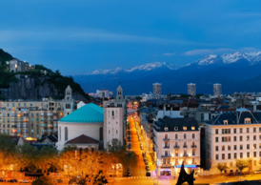
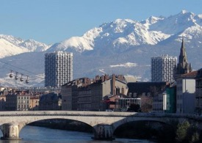
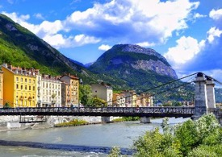
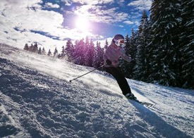
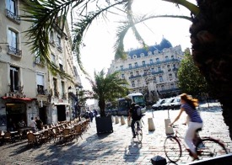
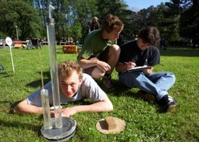
Grenoble
A green, sporty and scientific city

Slide 12
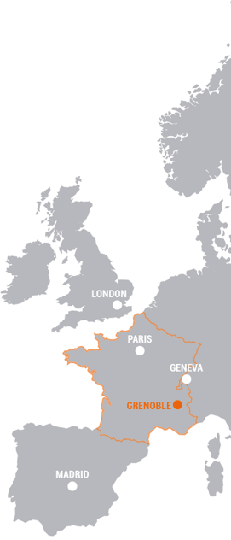
Grenoble, in figures
« French Tech » accredited
since 2014
(grenoble-digital.com)
3hours from Paris
1.5 hours
from Geneva or Lyon
5th best city in France
for students
7,1%
of the population
works in R&D
1
innovative city
3rd ranked European city of the futur
(The Financial Times 2016)
9th conurbation
in France

Slide 14
An unconventional school
An international school of paper since 1907,
with an additional focus on print media since 1980 and biomaterials since 2008
A state funded school that covers the entire plant biomass valorization chain
from the wood, to functionalized biobased materials to printed eletronics
ISO
9001
14001
45001
A French engineering school with Quality Safety Environment certification
Combined with an international research laboratory: LGP2

Slide 15
A school on a human scale
A green school that caters for the challenges
and sectors of the present and future
1 engineering degree (Masters)
Paper science,
Print media
and biomaterials
2 paths
Fibre and Biomaterials engineering
Print Media engineering
2 statuses → Student or Apprentice
1 international masters
Material science and engineering with
biorafinery and biomaterials courses
International semesters
&
Winter school

Slide 16
Engineering degree
3 years of study
Year 1
Bachelors 3
S5
Engineering sciences
S6
Operator internship (6 weeks)
ou
Work-study program
Year 2
Masters 1
S7
Fibre Engineering and Biomaterials option (IFB)
Print Media Engineering
option (ICI)
ou
S8
Assistant engineer internship (2-3 months)
ou
Work-study program
Year 3
Masters 2
Product
Company
Project
International semester
ou
Double degree
S9
ou
S10
Final year project (5-6 months)
ou
Work-study program

Slide 17
Master Biorefinery & Biomaterials
2 years of study
Year 1
Masters 1
S7
Process engineering methods (common core module)
S8
Introduction to biorefinery
And bioproducts
In English, Grenoble INP - Phelma
In English, Grenoble INP - Pagora
Year 2
Masters 2
S9
Biorefinery
and advanced biomaterials
R&D
(research & development)
S10
In English, Grenoble INP - Pagora
In English or in French, Project within a company or at LGP2 (or another laboratory)
Apprenticeship training available to French students in their second year.

Slide 18
One year Master Program Biorefinery & Biomaterials
Plant biomass, towards a green future
This training is provided in English
Open to engineers
& masters
Duration: 1 year
from September to July
Grenoble INP – Phelma Grenoble INP – Pagora
The Biorefinery and Biomaterials Master program is aimed at students wishing to move towards the professions of valorization of plant biomass into chemicals, energy and biomaterials.

Slide 19
Chosen options – New Master’s program at Pagora
Creation of a International Master’s program within an existing Master
Grenoble INP - Génie Industriel => Master Génie Industriel
2 programs at Grenoble INP – Génie Industriel
Gestion Industrielle Durable (program in French)
Sustainable Industrial Engineering (program in English)
1 additional program at Grenoble INP – Pagora
Sustainable printed and integrated electronics (program in English)
2 semesters to built in M2
1 semester of lectures
1 semester of internship
Beginning with 12 students (then increase to 25 students)

Slide 20
International semesters
At Grenoble INP – Pagora
Paper Sciences, Biorefinery
& Biomaterials
Master level
30 CR ECTS
Print Sciences:
Processes and Materials
Digital Media
& Functional Printing
1 semester
Courses in english

Slide 21
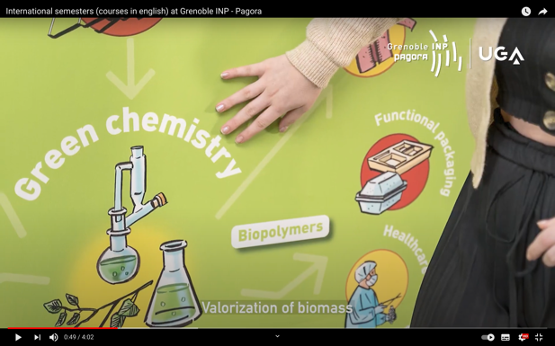
International semesters
Video presentation
of the international semesters

Slide 23
Grenoble INP – Pagora
… is on social media
Facebook – YouTube – LinkedIn
Join us
… and shares its news via the newsletter
La fibre de l’innovation
Subscribe

Slide 24
Thank you for your attention
Lucile Potiron
Lucile.potiron@grenoble-inp.fr

